Slide 1
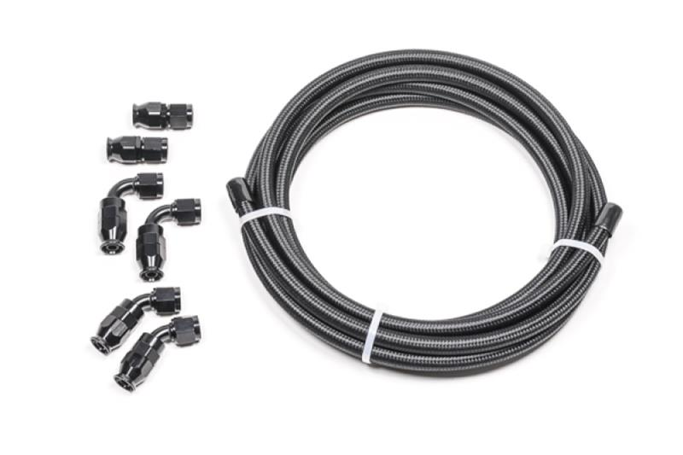
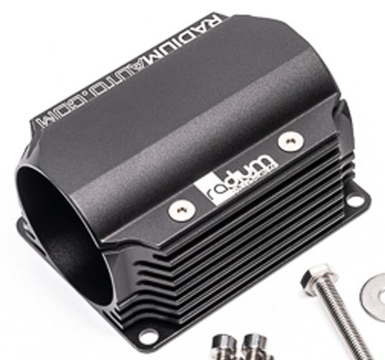
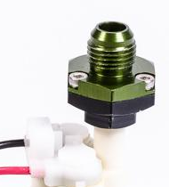
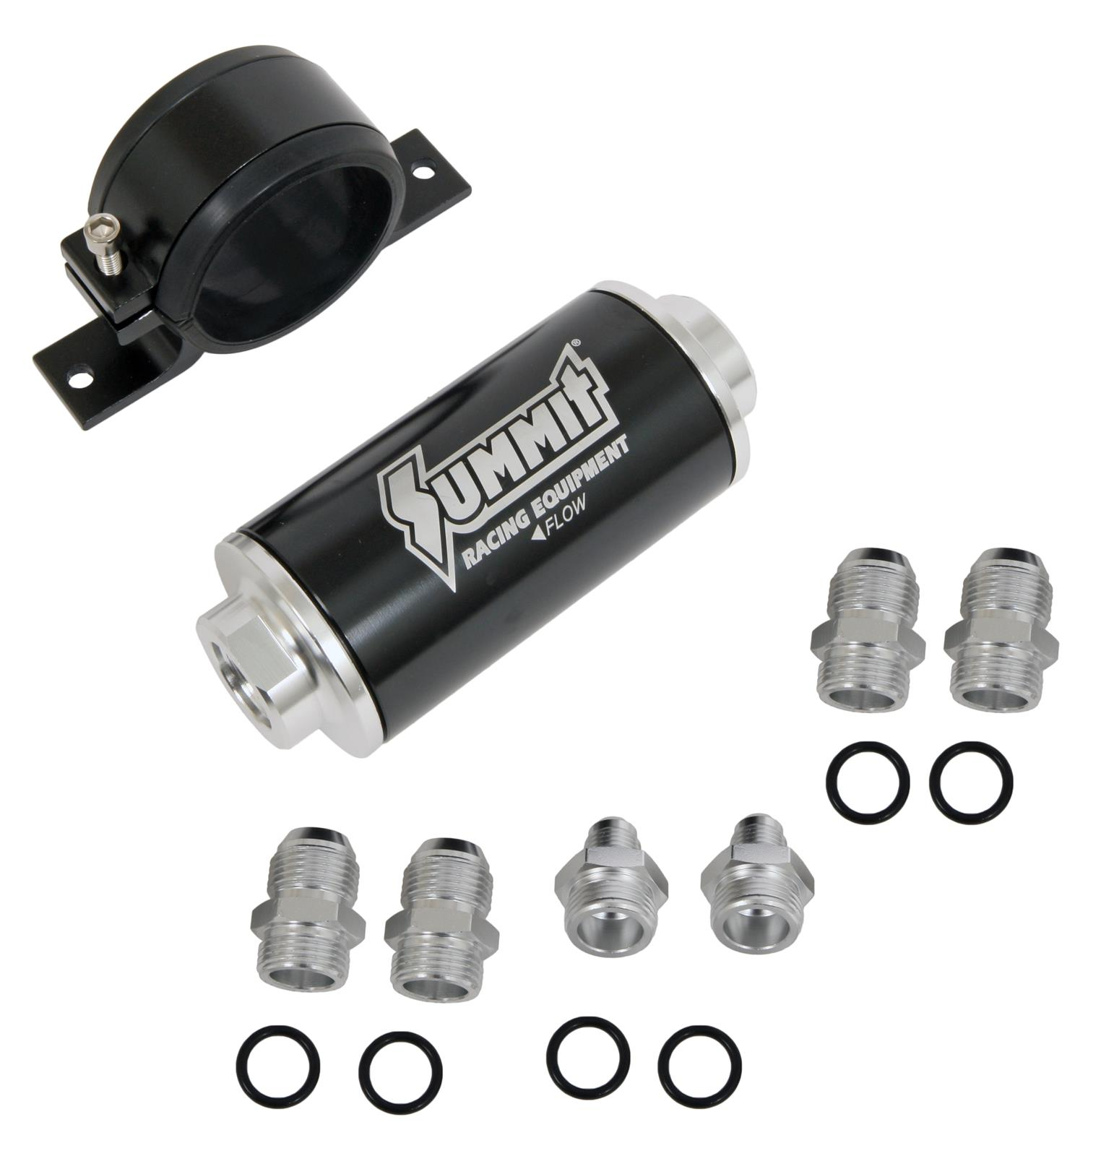
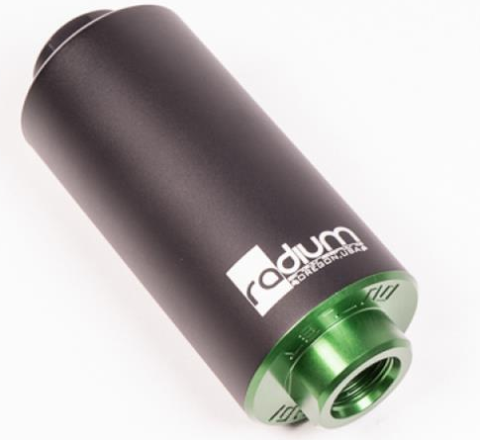
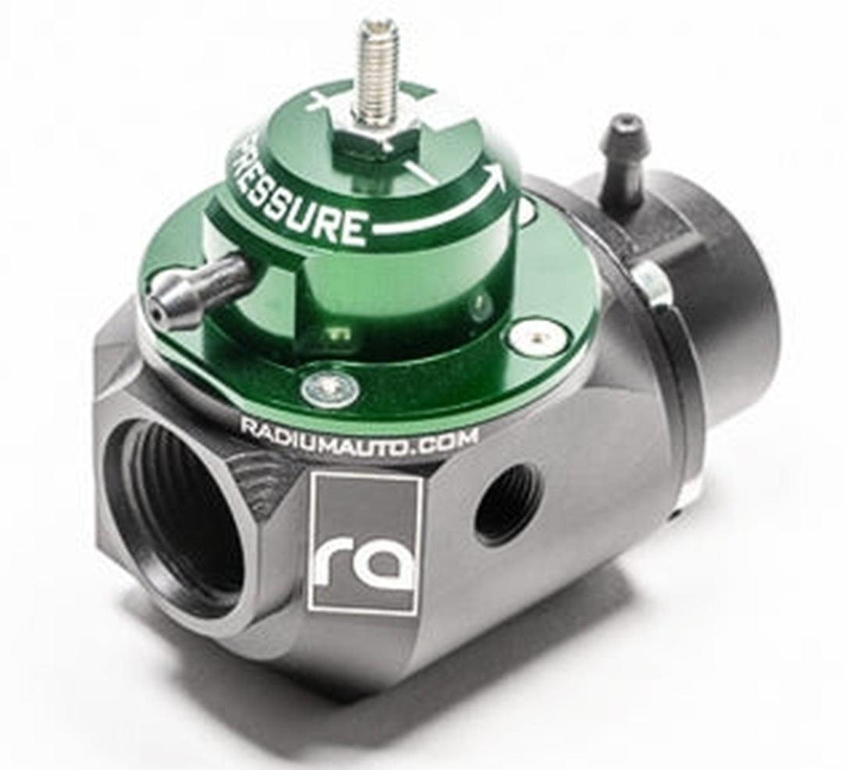
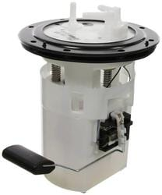
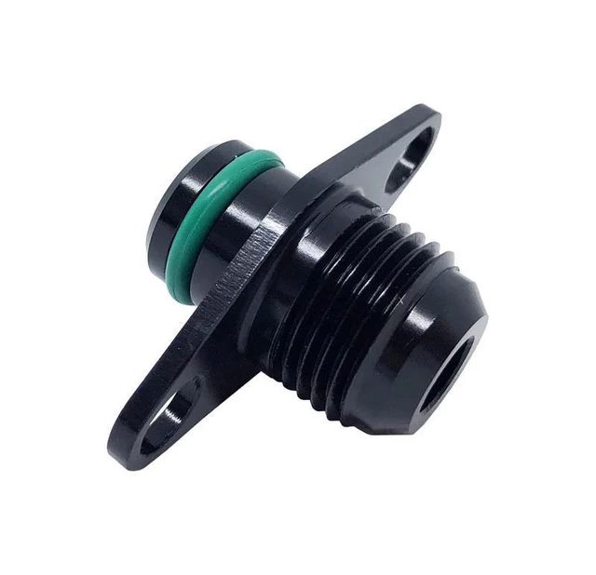
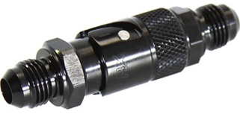
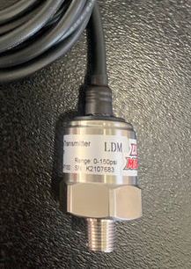
Fuel System Diagram
Firewall
6 AN Hose Ends
8x
4x
4x
Fuel Tank
10μm Radium Filter w/ heatsink
6AN Pump Adapter
100μm Summit Filter
Braided PTFE 6AN Hose
OE Fuel Pump
Plastic Barb
6 AN dry break fitting
6AN Barb Adapter
Plastic Barb
Fuel Pressure Regulator/Damper
6AN Rail Adapter
6AN
Rail Adapter
6 AN dry break fitting
Low Pressure Return Line
1/8 NPT sensor
OE Fuel Rail

Slide 2
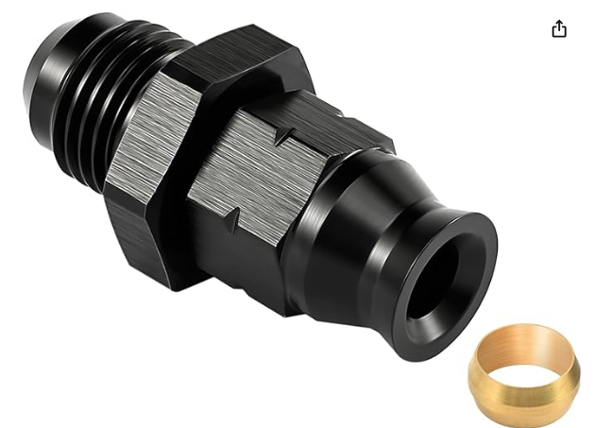
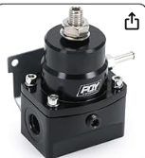
Fuel System Diagram
6 AN Hose Ends
Firewall
2x
3x
Braided PTFE 6AN Hose
Amazon FPR
Fuel Tank
6 AN to 5/16 hard line compression fitting
OE Fuel Pump
Plastic Barb
Hard Line Feed 5/16”
1/8 NPT sensor
Plastic Barb
Hard Line Return ¼”
6 AN to ¼ hard line compression fitting
6AN Rail Adapter
6AN
Rail Adapter
OE Fuel Rail

Slide 3
Fuel System Goals: Maximize Reliability and Tuning Control
Eliminate leaks and line failures under race conditions
Replace every rubber-on-barb feed, return and vapor line with braided PTFE 6 AN hoses and proper threaded fittings for a fully flare-sealed system. Dry-break quick-disconnect fittings immediately before and after the rail allow fast engine removal.
Lower seat & minimize fuel heating and vapor lock risk from nearby exhaust
Reroute and extend all hard and soft lines outboard of the driver’s seatwell, securing them with new chassis-mount AN brackets and stainless-steel clamps. Fit a radial-mount heat sink on the fuel filter.
Steady fuel pressure through all RPM and cornering loads
Install a Radium Engineering combined adjustable fuel-pressure regulator + damper at the firewall feed bulkhead, plumbing in-6 AN inlet and outlet lines for minimal restriction.
Prevent debris and contamination from clogging injectors or reaching the newly machined engine
Fit a dual-stage inline filtration setup in the feed circuit: a 10 µm fine filter directly upstream of the fuel rail and a 100 µm coarse filter to prevent clogging.

Slide 4
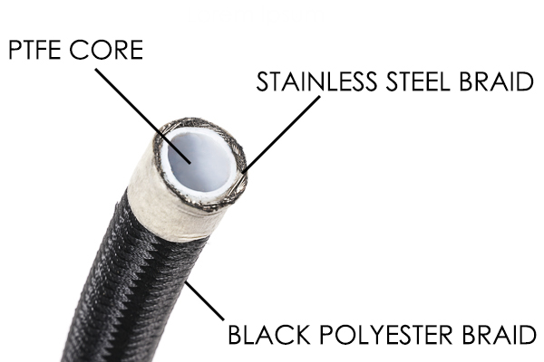
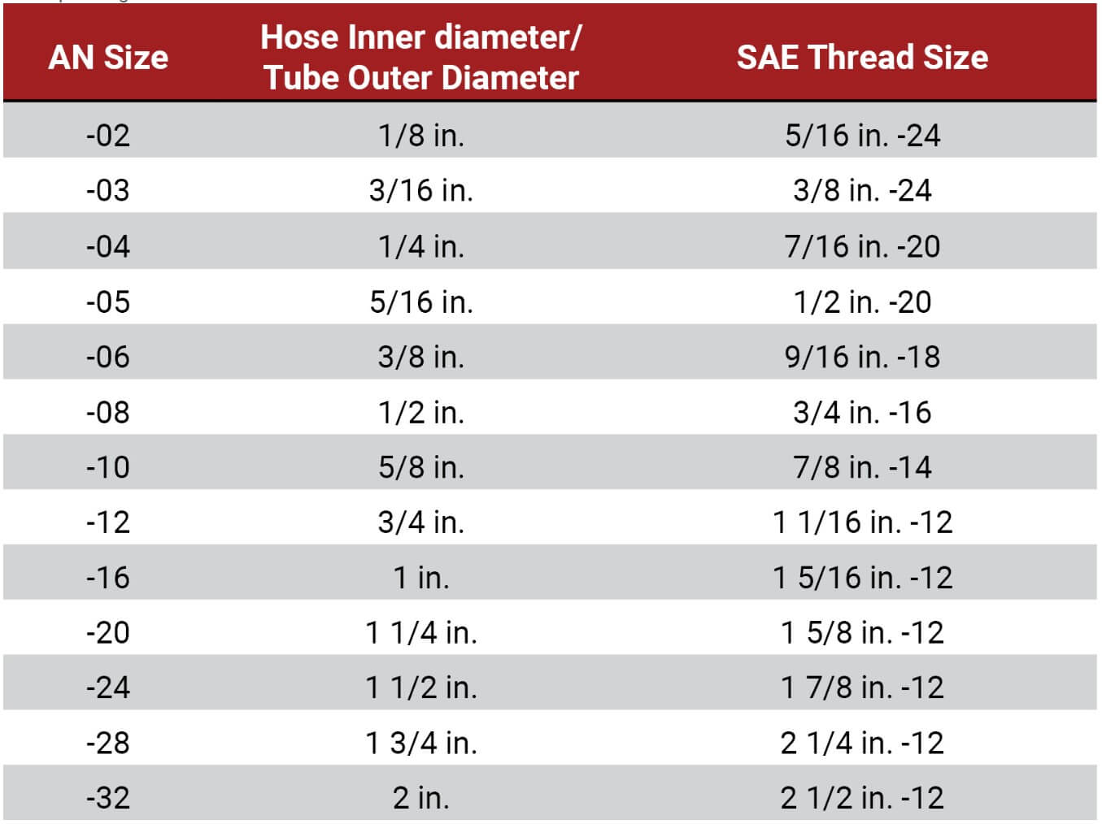
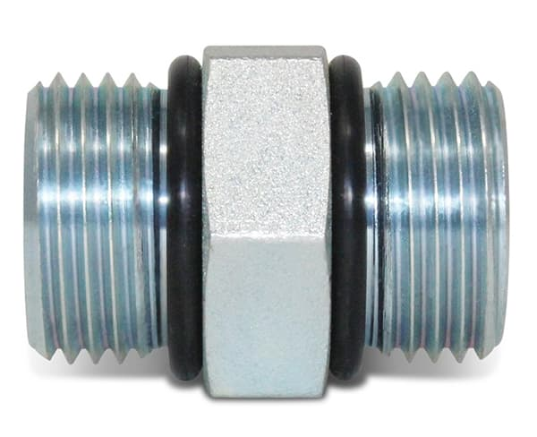
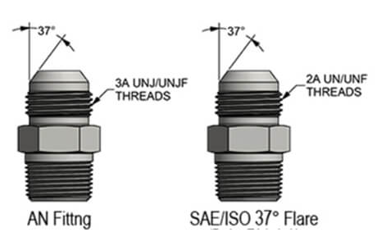
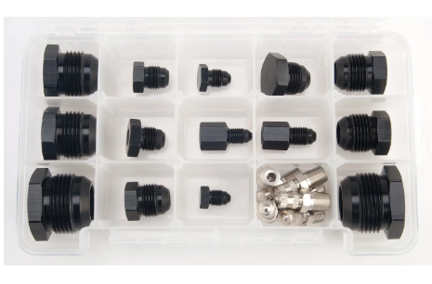
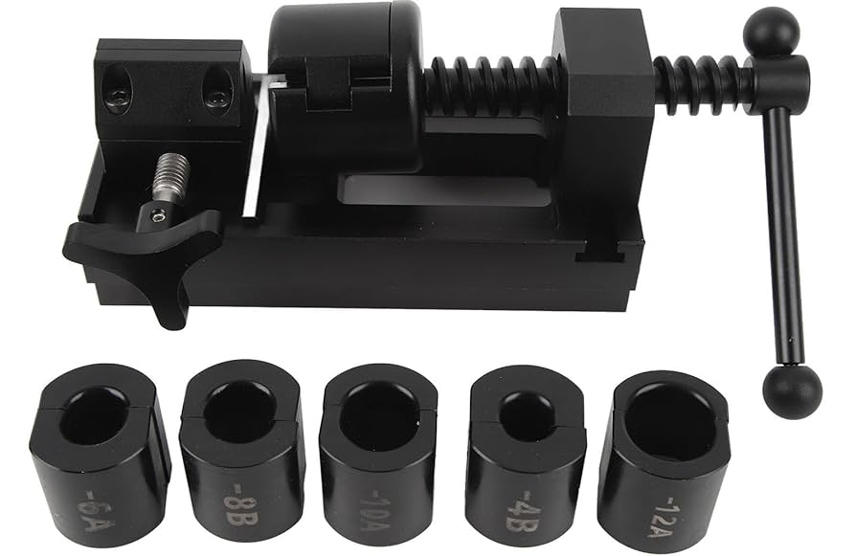
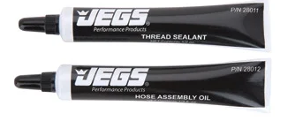
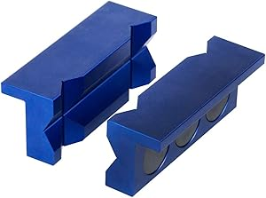
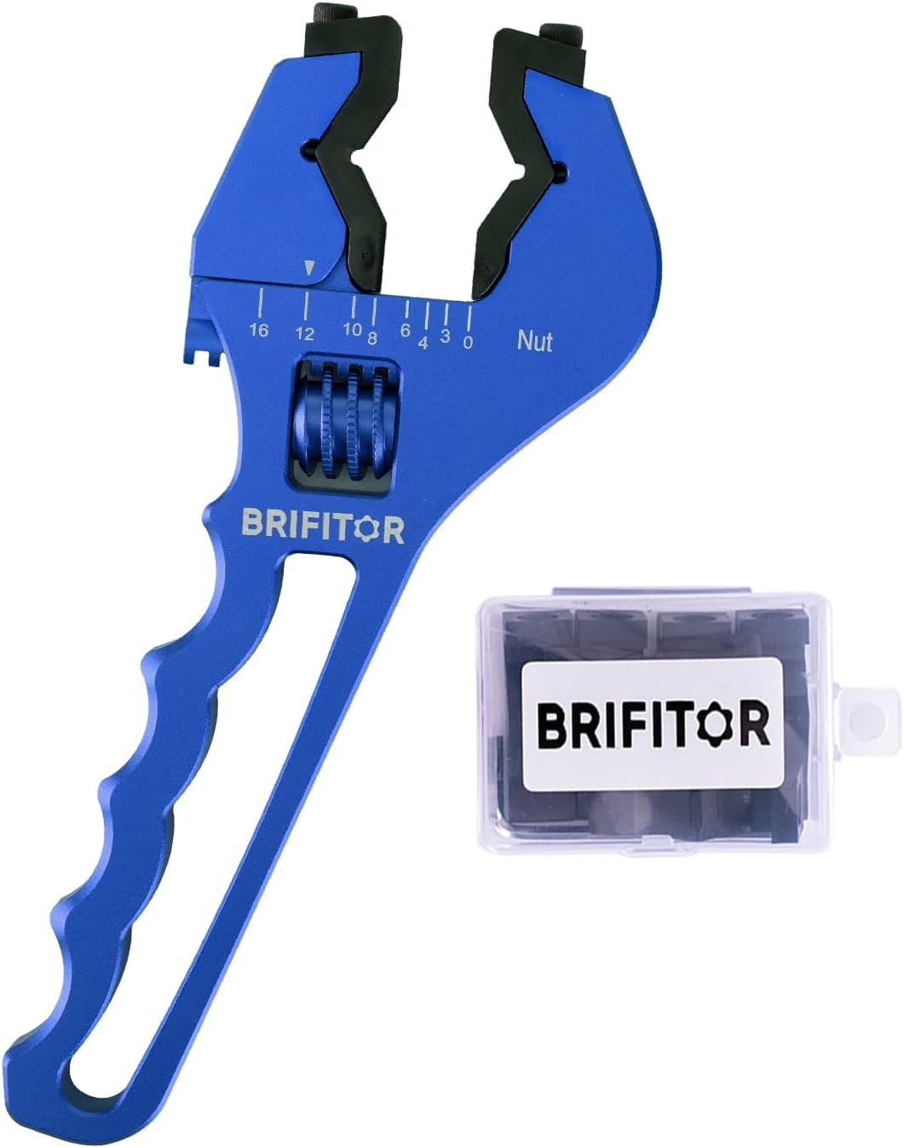
AN Hose Info & Installation
Rubber vs PTFE Comparison All Radium Engineering PTFE hoses have been successfully tested in-house to 1200psi although PTFE can typically withstand 2500psi+. They are also for extreme temperatures (-94F to +480F). They feature an extruded PTFE (fluoropolymer) core wrapped in a stainless steel wire braided sleeve. The outer coating for the universal DIY ends is braided PET. All hose ends are type-II black anodized aluminum.
Fitting Type Overview. The White Tiburon will use a combination of AN, ORB and NPT fittings for sensor taps fuel and power steering steering. DO NOT use tape or sealant on AN or ORB fittings and DO NOIT use AN or ORB with different flare-type fittings.
AN fittings are a flare fitting, using 37° flared tubing to form a metal-to-metal seal, meet SAE Aerospace (AS) standards.
ORB fittings are Commonly knowns as the O-ring boss (ORB), these types of fittings are defined by the SAE J1926 standard. The O-ring allows for an extremely tight seal that can withstand high pressures, useful for hydraulic and other automotive applications.
How to use AN Hose Installation Tool
How to Pressure Test Assembled Hose
Connect hose ends to fittings with AN hose wrench & only clamp with vise protector

Slide 5
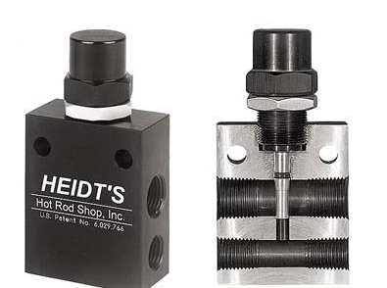
Power Steering Diagram
Firewall
Steering Rack
Power Steering Pump
Braided PTFE 6AN Hose
10 AN dry break fitting
Power Steering Reservoir
Braided PTFE 10AN Hose

